Slide 1



FRAUD DETECTION IN HEALTH INSURANCE
USING EXCEL, POWER BI,MYSQL
PROJECT LINK (GOOGLE DRIVE)
https://drive.google.com/drive/folders/1NK1pMsRSZRlWktjGHZjJPmKbUPLhP55-?usp=sharing
- BY MANISHA CHAUDHARY

Slide 2
INTRODUCTION
Provider Fraud is one of the biggest problems facing Medicare. According to the government, the total Medicare spending increased exponentially due to frauds in Medicare claims. Healthcare fraud is an organized crime which involves peers of providers, physicians, beneficiaries acting together to make fraud claims.
Rigorous analysis of Medicare data has yielded many physicians who indulge in fraud. They adopt ways in which an ambiguous diagnosis code is used to adopt costliest procedures and drugs. Insurance companies are the most vulnerable institutions impacted due to these bad practices. Due to this reason, insurance companies increased their insurance premiums and as result healthcare is becoming costly matter day by day.

Slide 3
OBJECTIVE OF THE PROJECT
Healthcare fraud and abuse take many forms. Some of the most common types of frauds by providers are:
a) Billing for services that were not provided.
b) Duplicate submission of a claim for the same service.
c) Misrepresenting the service provided.
d) Charging for a more complex or expensive service than was not actually provided.
e) Billing for a covered service when the service actually provided was not covered.
GOAL - The goal of this project is to " predict the potentially fraudulent providers " based on the claims filed by them. Along with this, I have also discovered important variables helpful in detecting the behaviour of potentially fraud providers . It also involves study of fraudulent patterns in the provider's claims to understand the future behaviour of providers.

Slide 4
INTRODUCTION TO DATASET
For the purpose of this project, we are considering Inpatient claims, Outpatient claims and Beneficiary details of each provider. The details are as follows:
A) Inpatient Data
This data provides insights about the claims filed for those patients who are admitted in the hospitals. It also provides additional details like their admission and discharge dates and admit diagnosis code.
B) Outpatient Data
This data provides details about the claims filed for those patients who visit hospitals and not admitted in it.
C) Beneficiary Details Data
This data contains beneficiary KYC details like health conditions ,region they belong to, age,gender, etc.

Slide 5
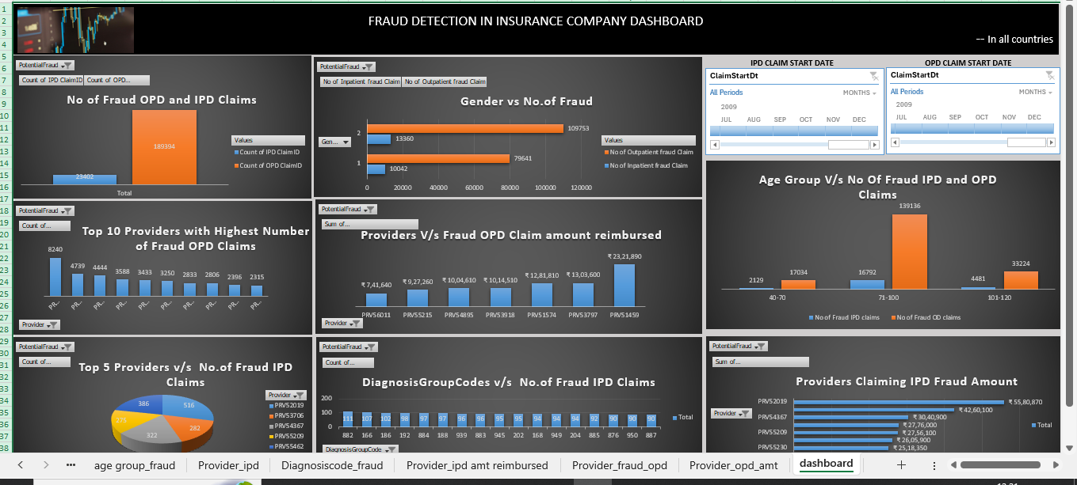
DASHBOARD CREATED USING EXCEL
Using pivot tables , slicers,visuals,etc

Slide 6
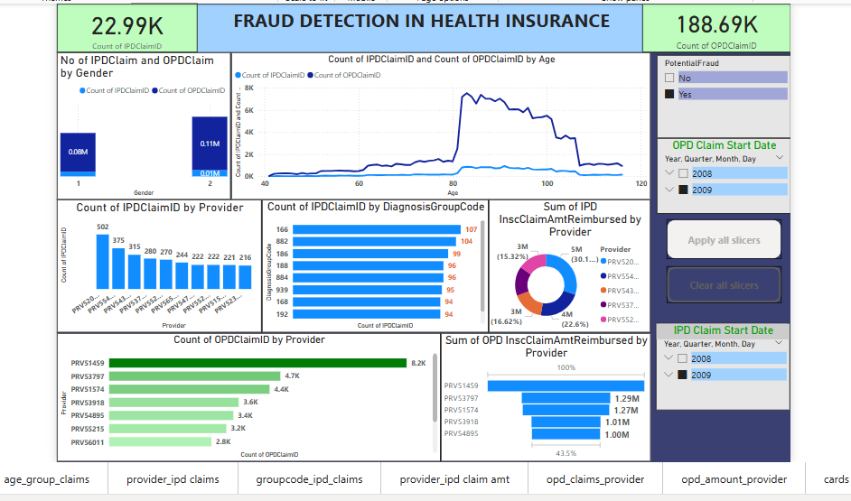
DASHBOARD CREATED USING POWER BI
Creating visuals,slicers,cards,buttons,etc in Power BI Desktop

Slide 7
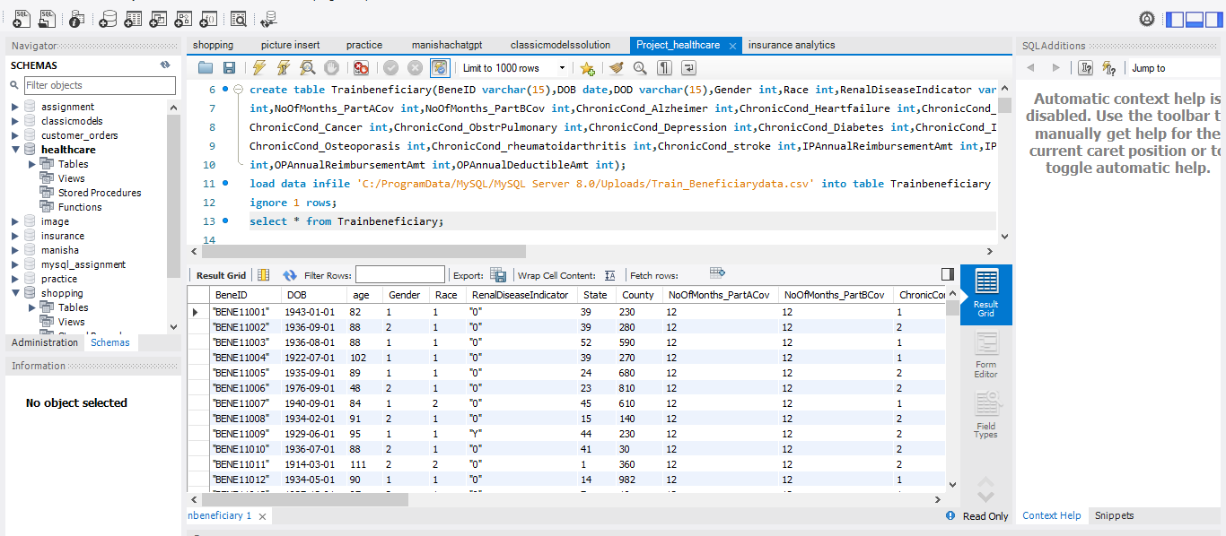
FRAUD DETECTION USING SQL
Running queries in MySQL Workbench to detect fraud patterns in dataset

Slide 8
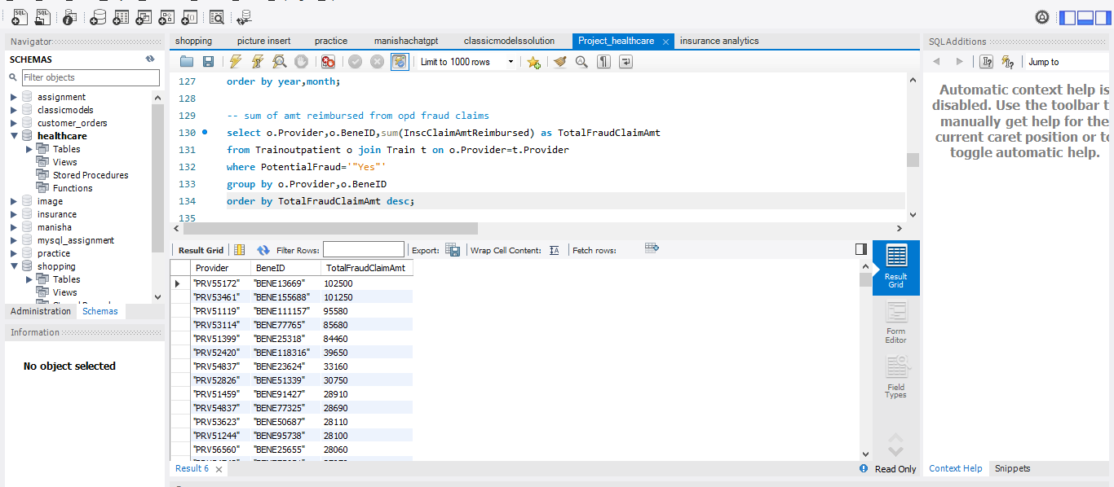
DETECTING PATTERNS BY RUNNING COMMANDS
Fraud detecting patterns

Slide 9
DRAWBACKS OF TOOLS USED
MySql – It allows to import the data .Simple queries are executed smoothly .But complex ‘join’ commands takes time to execute depending upon the size complexity of large data sets.
It doesn’t provide visual presentation of datasets .
EXCEL – It is proficient in handling large datasets .But it doesn’t allow grouping of data when we are dealing with pivoting data among different tables, i.e “cross table pivoting “. So ,basic excel formulas are used to handle the bugs .
Excel doesn’t have the features of KPI cards ,dynamic titles ,focus mode for visuals ,etc.
MOST EFFECTIVE TOOL USED
Power BI- It allows to import very large size of dataset proficiently. It is used to easily create visuals using
Dax formula and measures .
It has the feature of creating dynamic titles using measure , focus mode for each visual , slicers , buttons , kpi cards and
Large variety of visuals forms.

Slide 10
THANKYOU

